Slide 1

Computer Programming for Engineers
Week 10 Lecture 2
Nov. 3, 2022
Lecturer: Mohammad Mahdi Javidan
College of Engineering, Sungkyunkwan University
Fall Semester 2022

Slide 2
Topics Covered
Introduction: programming languages, installation, mathematical and logical operations
Variables, data types, and expressions
Algorithm development, flowchart
Iteration, branches, loops, etc.
User-defined functions
Plotting and data visualization
Root finding: bisection method, Newton’s method
Recursion: Series, Fibonacci numbers, Hanoi tower, etc.
Linear algebra and systems of linear equations
Solving example questions
Midterm exam
Complexity: efficiency of algorithms
I/O functions: and data management
Monte Carlo simulation: fundamentals of MCS
Group project
Least squares regression: theory and application of least squares fitting
Errors, good practice of programming, and debugging
College of Engineering, Sungkyunkwan University

Slide 3
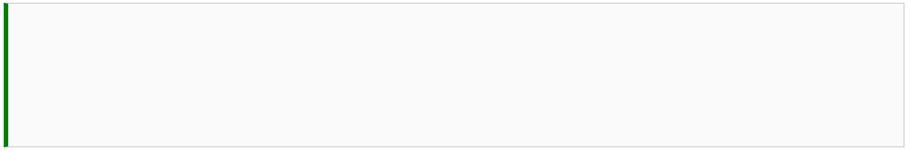

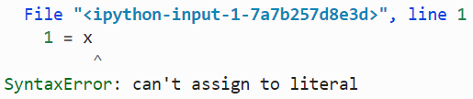

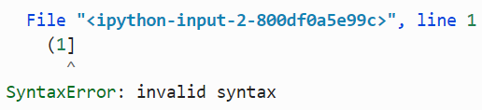

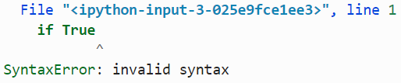
Error Types
Three basic types of errors:
Syntax error
Exceptions or Runtime error
Logical error
College of Engineering, Sungkyunkwan University

Slide 4
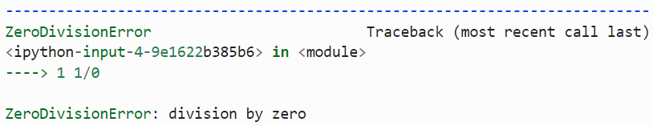

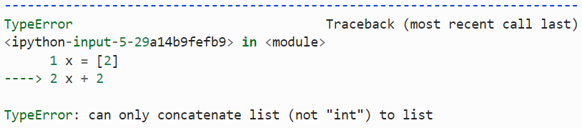

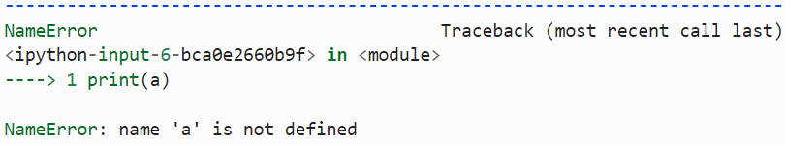
Error Types
Runtime errors occur during execution and can be detected when you run the code
ZeroDivisionError
Exception name
TypeError
NameError
College of Engineering, Sungkyunkwan University

Slide 5
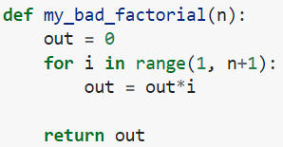


Error Types
Logical errors are very hard to find when the program is complicated
College of Engineering, Sungkyunkwan University

Slide 6
How to Avoid Errors
Plan your program
Outline your program.
Write inputs and outputs.
Write the tasks from top to bottom.
Each task is a module, a certain function or group of functions.
Tasks that are repeated are better to be written as a module.
When the modules are small enough that you can write them without error, start to write.
College of Engineering, Sungkyunkwan University

Slide 7
How to Avoid Errors
Test everything!
Test every module and function with a known answer.
Make sure that every module works correctly, especially when a module calls another one.
When a module has several steps, try to test each step before moving on to the next step.
Never write pages of code without testing.
Testing a module
Test a function indicating whether a number is prime or not with various cases:
0 (corner case)
1 (corner case)
2 (simple)
4 (simple)
97 (complicated)
College of Engineering, Sungkyunkwan University

Slide 8


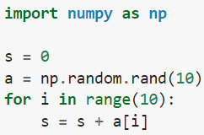
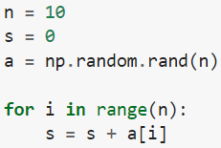

How to Avoid Errors
Keep your code clean!
Fewer instructions are better.
The more you write, the more probable it is to make a mistake!
Use variables instead of numbers!
It is easier to understand that n is the number of random numbers.
It is indicated at the beginning.
You can also change the number easily when you need it.
College of Engineering, Sungkyunkwan University

Slide 9
How to Avoid Errors
Keep your code clean!
Use short and descriptive variable names.
Use comments frequently.
Over-commenting is bad practice.
College of Engineering, Sungkyunkwan University

Slide 10
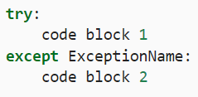
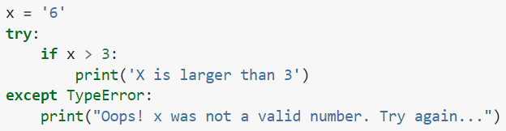
Try/Except
A Try-Except statement handles errors and exceptions without stopping your program
Handler
College of Engineering, Sungkyunkwan University

Slide 11
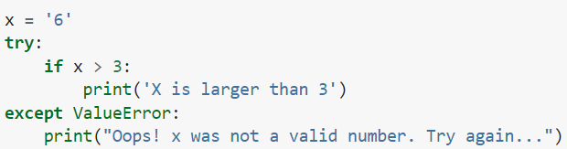
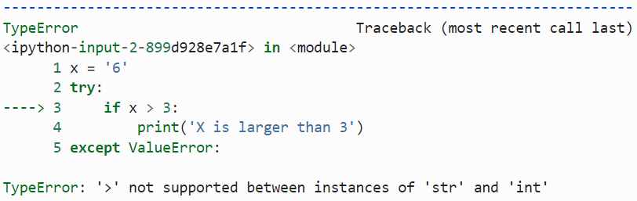
Try/Except
When there is no proper handler
College of Engineering, Sungkyunkwan University

Slide 12
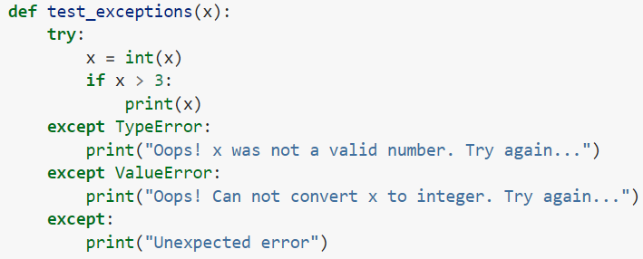


Try/Except
Handling multiple exceptions
College of Engineering, Sungkyunkwan University

Slide 13
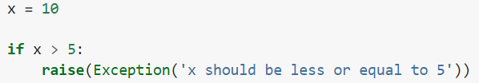
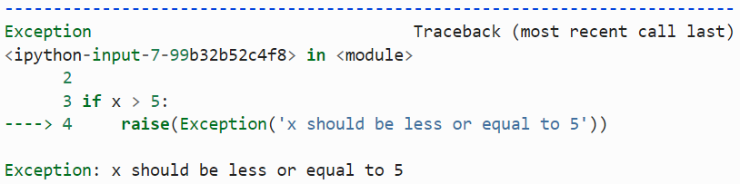
Try/Except
Raising exceptions when you need something specific
Finally, try-except statements cannot be replaced with good programming
College of Engineering, Sungkyunkwan University

Slide 14
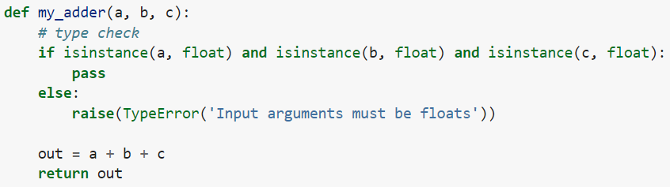

Type Checking
Ensuring that the input variables are your expected data types
College of Engineering, Sungkyunkwan University

Slide 15
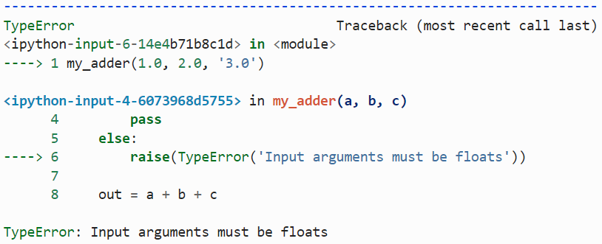
Type Checking
College of Engineering, Sungkyunkwan University

Slide 16
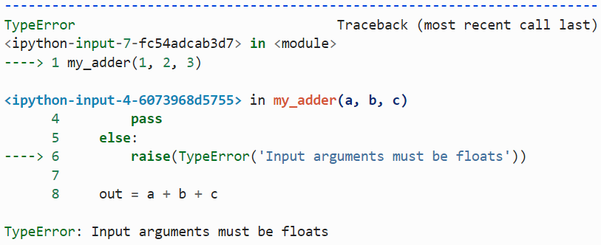
Type Checking
College of Engineering, Sungkyunkwan University

Slide 17
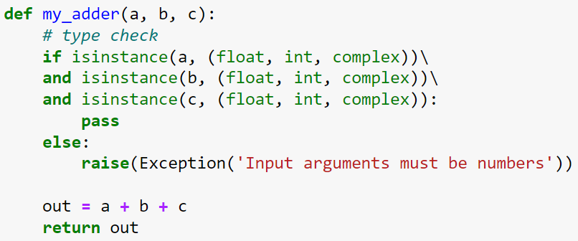






Type Checking
College of Engineering, Sungkyunkwan University

Slide 18
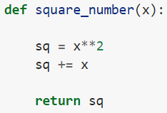
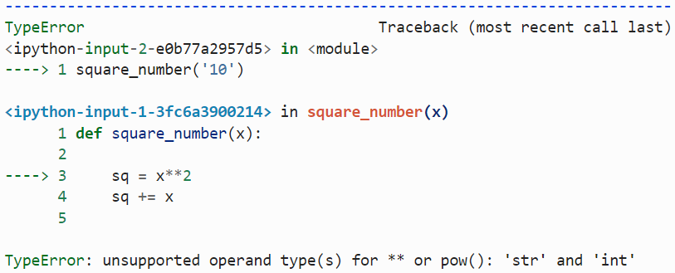
Debugging
Debugging is the process of systematically removing bugs and errors
IPDB stands for Interactive Python Debugger
Debugger can be run in two ways:
activate the debugger after we run into an exception.
activate debugger before we run the code.
College of Engineering, Sungkyunkwan University

Slide 19

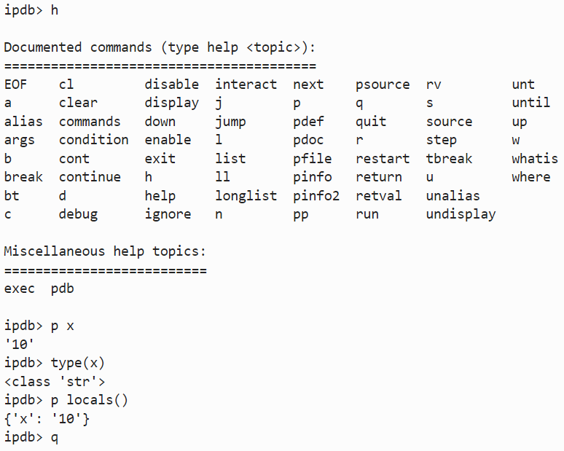
Debugging
h to get a list of help
p x to print the value of x
type(x) to get the type of x
p locals() to print out all the local variables
College of Engineering, Sungkyunkwan University

Slide 20

Debugging
Running in the debugging mode
College of Engineering, Sungkyunkwan University

Slide 21
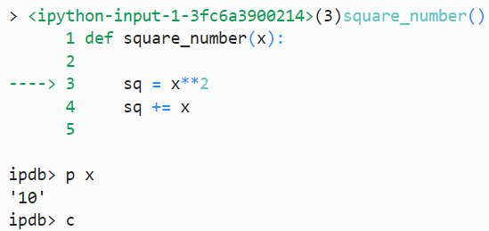

Debugging
turning it off after we finish running the code
College of Engineering, Sungkyunkwan University

Slide 22

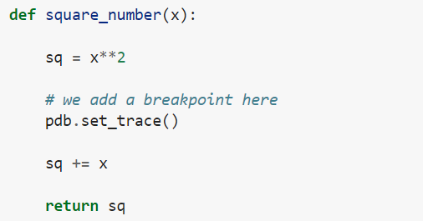
Debugging
Adding a breakpoint
College of Engineering, Sungkyunkwan University

Slide 23

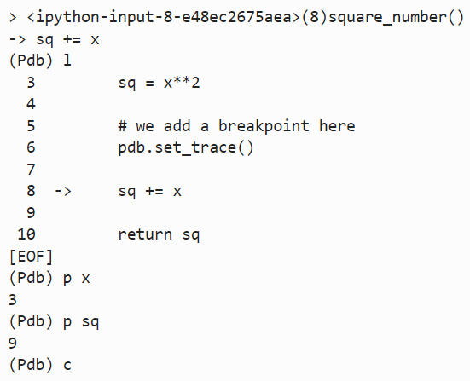

Debugging
College of Engineering, Sungkyunkwan University

